Slide 1

We Engineer your Digital Success
Proposal for Development of an Mobile Product Cataloguing System for Fischer- UAE
Aug 2016
© 2016. All Rights Reserved / www.verbat.com

Slide 2

Contents
1
Background & Scope
2
Solution Overview
3
Application Functionality
4
Discovery Phase
5
Application Delivery
6
Technology Specification
7
Project Timeline
8
Deliverables
9
Commercials
10
Out of scope
11
Terms & Conditions

Slide 3
Background & Scope
Fischer is one of the world’s largest fixings manufacturers. Spanning 50 years of research and development, each product is created using a wealth of experience from the industry. Fischer’s largest division is the Fixing Systems with more than 14,000 articles. Fischer’s strength is in their capability to provide the right product in a technically-perfect design for a wide range of customers, from Do-It-Yourself (DIY) fans through to skilled trade workers.
Scope
Fischer intends to catalog it’s products along with example implementation of its products to be made available for the companies sales associates. A product catalog along with sample implementations will amplify the companies sales by providing associates the opportunity to demonstrate its product line while on the field.

Slide 4
Scope
Fischer has contacted Verbat to develop an application with the following features:
Approval Copies
A mobile device (Phone or Tablet) application that can take pictures of products
Ability to associate the product with a project, contractors, consultants, clients etc.
Approval Form
Create an approval form (option for draft and final) that can be send to approval managers for approval.
Approval copies once approved can be further enhanced with additional information
Product Catalog
Create a product catalog with various product details
Be able to attach documents from emails, scanned images or from the device storage.

Slide 5
Scope (Continued)
Submittal Forms
Create product or company submittal forms
Create cover page
Be able to add additional attachments via email, pics or device storage
Ability to combine all documents & attachments to be collated as a single PDF document
Application Platforms
System will be deployed on desktop as well as mobile devices
Administrative features will be implemented on the desktop version
All other features will be available on the mobile devices
System will be available on both IOS and Android devices

Slide 6
Solution Overview

Slide 7
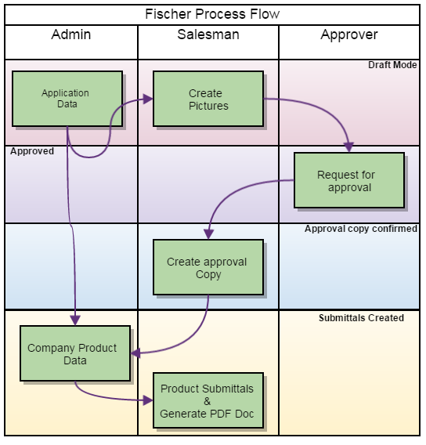
Solution Overview
The main components of the application are
Authentication, authorization to distinguish the logged in user, auditing to track the progress of the workflow (Created, Submitted, Approved, etc.)
The system consist of three distinct workflows
An Approval copy workflow
A Submittal form workflow
A Web application workflow to manage approvals and users
The above workflows are built on a common framework
Admin will create users as well as manage/maintain products
Salesman will create request for approval
Approval managers approve the request and make the approval copy available to other users
Managers and sales personal can create product and company submittals.
Submittals can be generated as PDF files along with associated attachments.

Slide 8



Detailed Process Flow
Start
Create or Search for product sheet
Create Cover
letter
Create Submittal
form
Collate & stitch to create PDF
End
Salesman Takes pictures of the Product
Attach additional
Reference materials
Salesman adds additional details for the request
Approval Copy Converted to PDF and ready to be printed
No
Check whether request details are complete
Save as Draft
Salesman Submits request for approval
Request Approved
Prepare approval Copy
Yes
Reference materials attached
Salesman
Approval Manager

Slide 9



Create Users and Application Data
Application Pictures
&
Reference Information
Create Approval Copies
Create Product Data
Create
Submittals
Historical Data for Recall & Reporting
Admin
Salesman
Approval Manager
Web Application
Mobile Application

Slide 10
Application Functionality

Slide 11
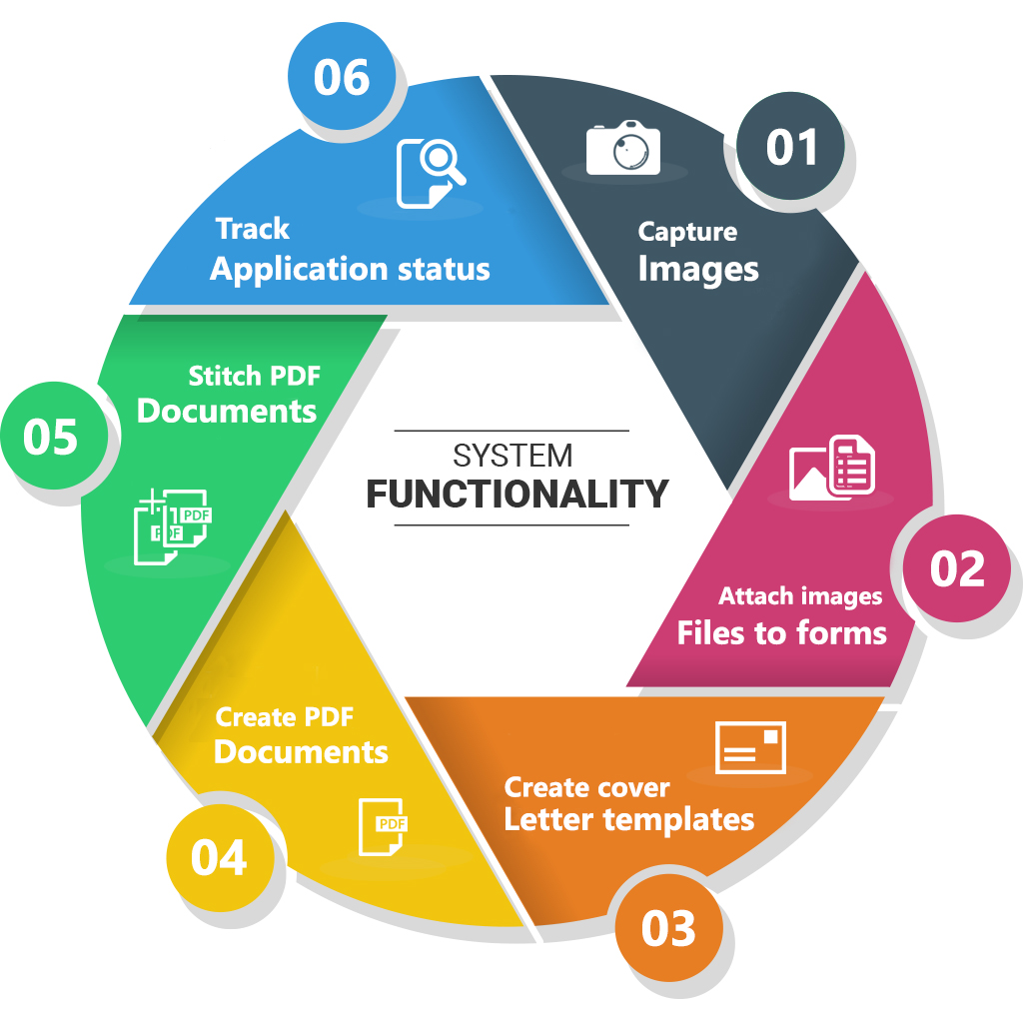
General Application Functionality
Functionality for capturing pictures
Functionality to attach images/files to forms
Functionality to create cover letter templates
Functionality to create PDF documents
Functionality to stitch PDF documents
Functionality to track the application status

Slide 12
Individual Component Functionality
Functionality for System Admins
Create application users, roles and privileges
Create company product data
Create master data such as Project types, companies, products, location, document types etc.
Functionality for Salesman
Take product pictures.
Search for products by project type, consultant, contractor, product name or application type.
Create request for approvals
Save draft copies of requests.
Create product and company submittals
Functionality for Approval Managers
Approval managers can approve request submitted for creating approval copies.
Can create product and company submittals
Can manage company products
Can list approval copies and product submittals
Can search for approval copies, product/company submittals, company products.

Slide 13
Discovery Phase

Slide 14
Requirements Gathering
On signing the contract, Verbat will deploy a senior Business Analyst to discuss the business and technical requirements, define the solution approach, deliverables during each phases of execution, documentation and sign-off
Deliverables
High level technical design
Detailed requirement specification document
Wireframes for the key screens for the proposed web application
Dependencies
The client to nominate a POC to coordinate with our team
Availability of key stakeholders for meetings to discuss requirements and validate findings and deliverables
Written sign-off on the deliverables prior to commencement of the development phase

Slide 15
Application Delivery

Slide 16
Application Delivery
Application will be delivered in three phases. Development will start post approval and sign-off of the Software Requirements Specification (SRS) by the client. The deliverables for each phase is listed below.
Phase 1 Delivery
Includes general application framework that consist of modules like authentication and authorization, Logging, API integration, Master data Maintenance , Splash Screen
Initiate approval workflow
Create request for approvals (draft and final)
Theme development for mobile devices and web
Database design and development

Slide 17
Application Delivery (Contd.)
Phase 2 Delivery
Approval workflow to approve request
Complete the approval copies (with additional information and attachments)
Create PDF documents
Complete product data features and relate it with approval copies and submittal forms so that they can be searchable
Phase 3 Delivery
Completion of the application and company submittals
Convert attachments to PDF documents
Stitch cover letter and attachments to create a PDF document

Slide 18
Technology Specification

Slide 19
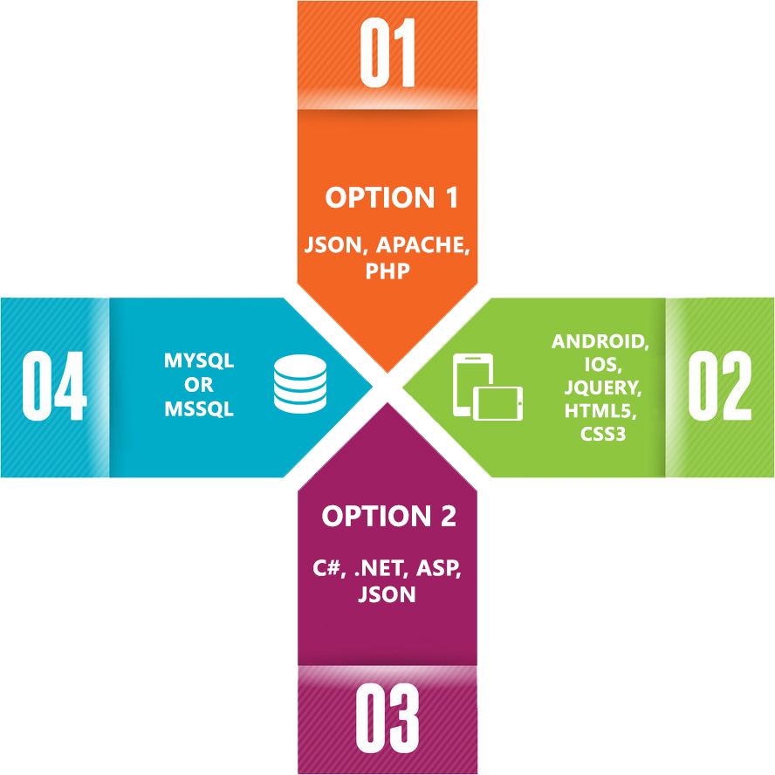
Technology Specifications
Technology Stack
Language – ASP.Net 4.5/PHP
Database – My SQL / MS SQL
Server – IIS 7.5 / Apache
Operating System – Windows/Linux
Server and Hosting
Dedicated Server
Memory – 8 GB with 4 Core CPU
HDD Quota – 1 TB Disk (Raid 1)
20 TB Monthly Bandwidth
SSL

Slide 20
Project Timeline & Commercials

Slide 21
Project Time line & Deliverables
The time estimated for delivering the application is 33 working man days
Activity | Timeline (Days)
Requirement Gathering Complete and Sign-Off(T0) | T0
Software requirement Specification | T0 + 1.5
Theme Selection & Application Prototype | T0 + 1.5
Prototype Approval | T1
Functional Specification Document | T1+1
Development Start | T2
Development Phase 1 | T2 + 9
Development Phase 2 | T2 + 8
Development Phase 3 | T2 + 7
Quality Assurance | T3 + 4*
UAT | T4
Go Live | T4 + 1
Deliverables
Software Requirement Specification (SRS)
High level technical design
Wireframes for the key screens
UI/UX Theme
Functional Specification Document (FS)
Test plans & Test cases
User Manual (English)
Fully developed and tested application for deployment (Phase 1)
Additional 2 days needed for regression testing*

Slide 22
Commercials
Sl. | Description | Cost
01. | Development of an Web/Mobile Product Cataloguing System | USD 00,000

Slide 23
Out of Scope

Slide 24
Out of Scope
Any other language other than English
Content / Image procurement or uploading or editing
Manual data entry
Integration to existing application (if any)
Database migration
Physical deployment at client’s site
Web Hosting & SSL
Backup solution and Disaster recovery
Content writing
Third party software integration
Annual Maintenance Contract

Slide 25
Terms & Conditions

Slide 26
Terms & Conditions
Offer Valid for 30 calendar days from the date of submission of the Proposal
An average of 20 working days are assumed in a month
This proposal and all technical/ functional specifications have been derived or concluded from the data shared via email / information's transferred during the initial requirement analysis meetings and conversations. Verbat reserves the right to amend the terms of this proposal, should the SOW terms, functional features and functionalities change during the course of the project
The applications will be built as per the specifications agreed mutually. Any changes will be executed through a deﬁned change management process between both parties
All Source Code and other project artefacts would adhere to the Verbat document templates and internal coding standards
Verbat will provide a bug ﬁx warranty at no additional cost for 30 days from the date of acceptance of the project, for correction of any errors in the developed application that may be attributed to Verbat
Acceptance criteria will be based on the clauses which were mutually discussed between Verbat and client at the Requirement Analysis phase and the same will be documented and approved by both parties through official emails

Slide 27



Contact Us
217, Sheikh Rashid Bldg
P.O Box 56272, Dubai United Arab Emirates
+971 04 2973236
Lekshmi.krishna@verbat.com
USA 2033 Gateway Place
Suite 500
San Jose , CA- 95110
India
Verbat Technologies (India) Pvt. Ltd. Level 3, PTC Tower Trivandrum, Kerala

Slide 28

Thank You
© 2016. All Rights Reserved Verbanet Technologies LLC www.verbat.com

